Slide 1



EMPLOYEE
ATTRITION
ANALYSIS

Slide 2

Employee Attrition?
Employee attrition is the gradual reduction in employee numbers.
Employee attrition happens when the size of your workforce diminishes over time.
This means that employees are leaving faster than they are hired.
Attrition is also called as total turnover or wastage rate

Slide 3





Type of Attrition
Involuntary
Voluntary
Retirement
Accepting a new Job offer
Position Elimination
Position elimination
Termination
Layoffs
Accepting a new job offer.
Making a career change
Termination Layoffs
Making a career change
Layoffs
Seek Feedback and Adapt
Seek Feedback and Adapt
Seek Feedback and Adapt

Slide 4

Effects of Attrition
01
01
Low productivity – Notice Period, Knowledge Transfer
02
Loss of Knowledge, expertise
03
Loss of picked up business relationships.
04
Negative impact on other team members.
05
Benefits to competitors
06
Excess work load
07
Interview Preparation
03
05

Slide 5

Insights

Slide 6
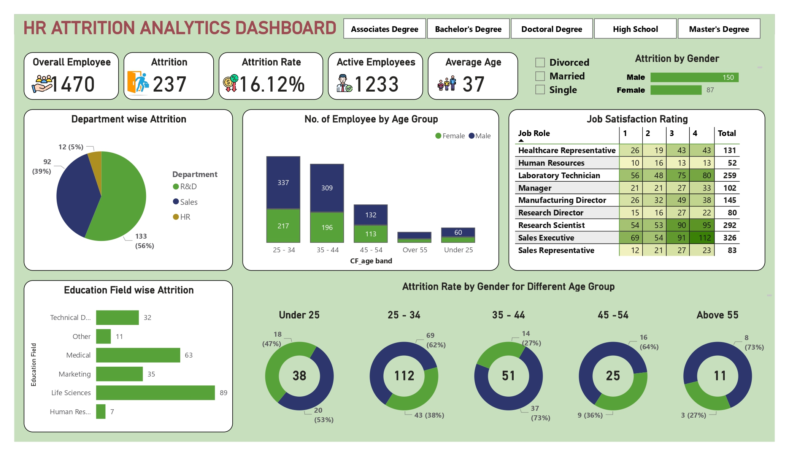
Taking all Department in to Consideration
Department wise attrition R&D > Sales >HR.
Education wise, Life Science is the biggest chunk.
Major attrition are in age group 25-34.
Major number of employees lie in age group 27 – 44.
Attrition of male > Attrition of female
Out 1470 employees 569(~39%) employees are not satisfied by there job which is worrisome (taking job satisfaction 1 and 2 into consideration).
TRENGTHS

Slide 7
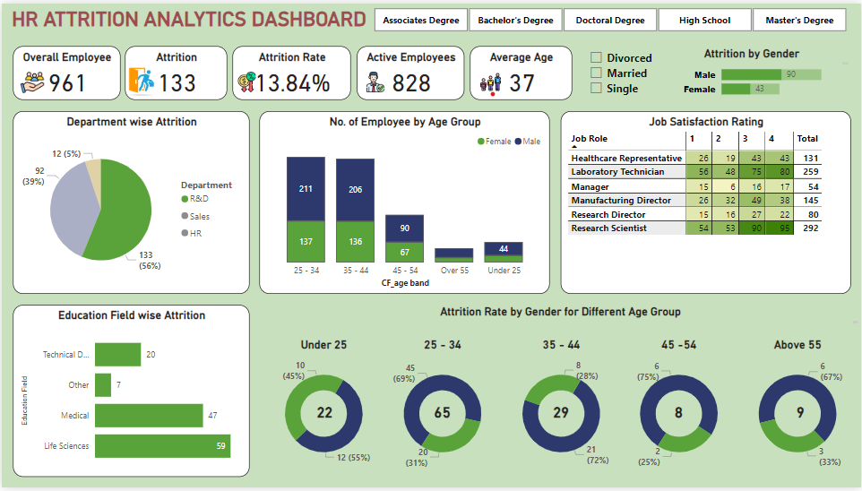
Taking R&D Department in to Consideration
In R&D department, Life Science is the biggest chunk of that.
Major portion are of the employee in age group between 25-34 (majority are male employees).
The reason for this as seen around 159 (~36%) of employees are not satisfied with their job (taking job satisfaction 1 and 2 into consideration).
If we take gender into consideration than there are nearly equal proportion of male and female are there who are not satisfies by their jobs.
Also if we consider in all age group then the number of male attrition(35) are more than female attrition(24).
TRENGTHS

Slide 8
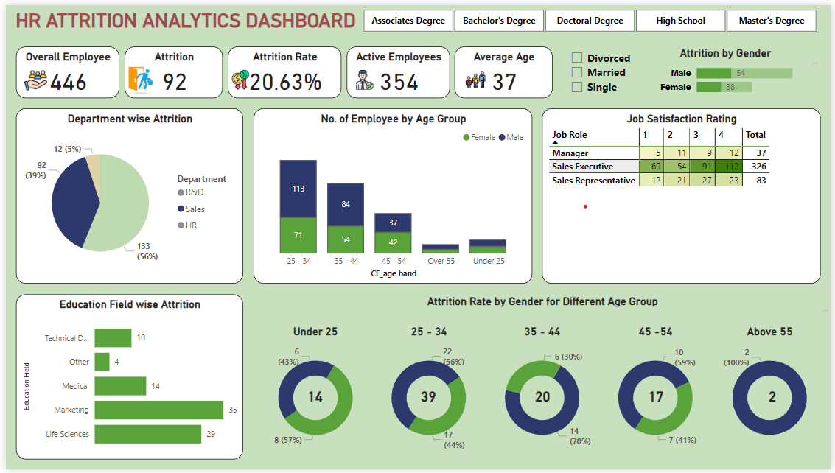
Taking Sales Department in to Consideration
In Sales department, Marketing and Life Science are the biggest chunk of that.
Major portion are of the employee in age group between 25-34.
The reason for this as seen around 123(~40%) of employees are not satisfied with their job (taking job satisfaction 1 and 2 into consideration).
If we take gender into consideration than there are equal proportion of male and female are there who are not satisfies by their jobs.
Also if we consider in all age group then the number of male attrition(36) are more than female attrition(28).
TRENGTHS

Slide 9
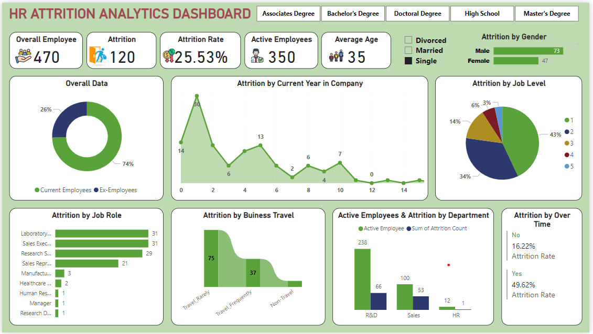
Taking other parameters in to Consideration
We have observed that single marital status employees tend to leave the company mostly within 0 to 1 year of joining. The majority of attrition occurs at Job Level 1, with the least at Job Level 5. This trend correlates with job dissatisfaction, particularly among employees rating their job satisfaction as 1 or 2.
Regarding Business Travel, employees who rarely travel are more likely to quit, possibly due to receiving better job offers closer to home.
Attrition rates are higher for job roles such as Laboratory, Sales Executive, and Research Specialist among single marital status employees.
TRENGTHS

Slide 10
Conclusion & Suggestions
The maximum attrition is taking place among employees in the age group of 25-34 years .
These are the segment of employees who are most likely to switch jobs are those with experience between 2-4 years.
Ways to reduce this attrition:-
Set realistic expectations
Offer support and show appreciation
Compensate fairly and recognize high performers
Allow for a more flexible work schedule.
In education field Major attrition are shown in Life sciences , Marketing and Human resource.
Ways to reduce attrition:-
Making sure that the right people are in the right roles at the right team.
Attrition among Male are more as compared to Females.
Lack of gender equality in the workplace has become a sore spot for organization as it can harm the company by increasing employee attrition.
Ways to reduce attrition:-
Bridging the gender pay gap.
Increase child care and paid time off.
Offer bias training for hiring management.

Slide 11

THANKYOU

